Slide 1



Grade 6

Slide 2
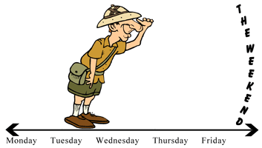
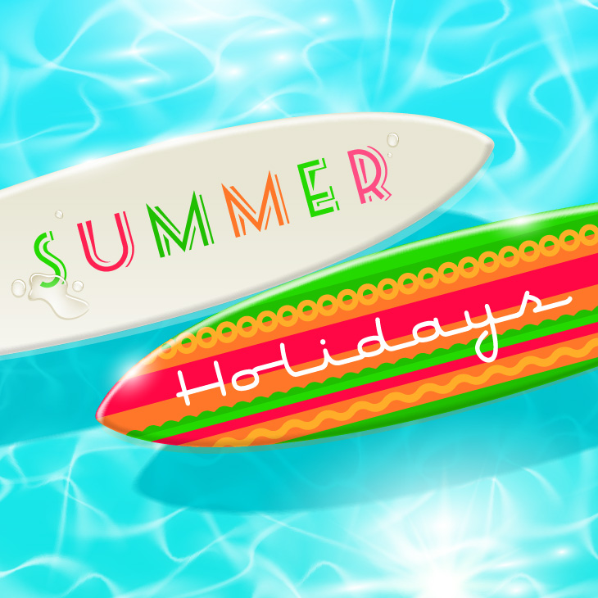
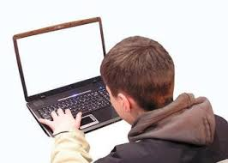


look forward to
I’m looking forward to the summer holiday.

Slide 3


final
As soon as I finish my final exam, I’m going to buy new boots.

Slide 4

My friend Sami likes swimming. He is going to take part in Kuwait Swimming Championship this year.

Slide 5
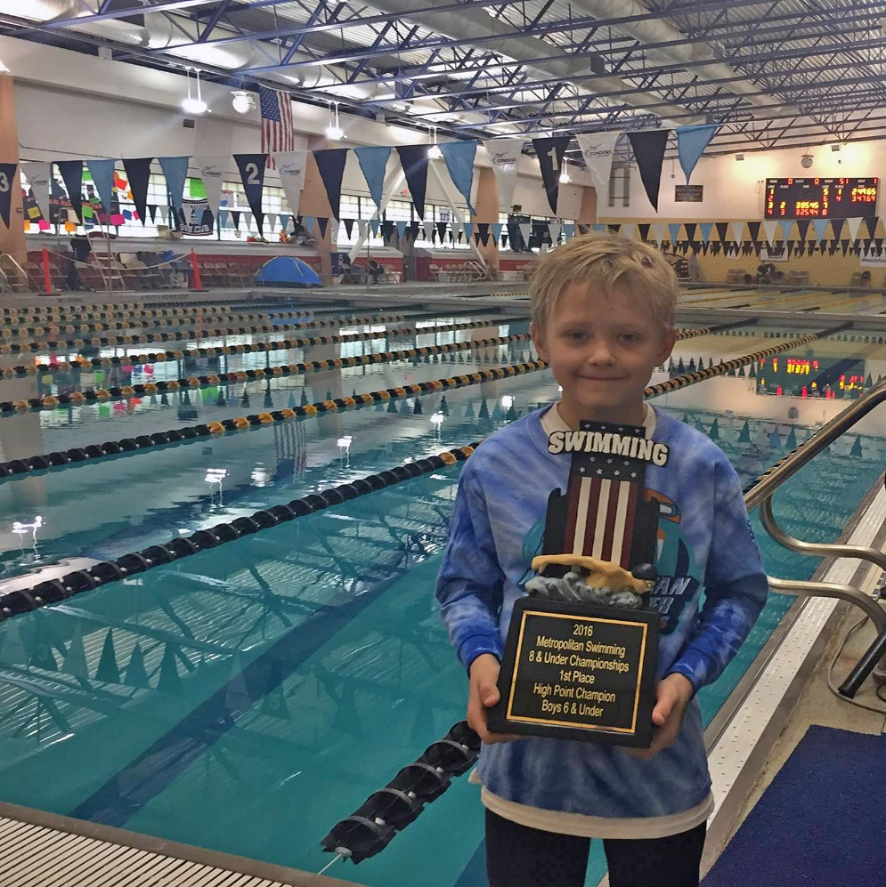

Sami is going to take part in
Kuwait Swimming Championship.
I’m
a champion.

Slide 6






Slide 7
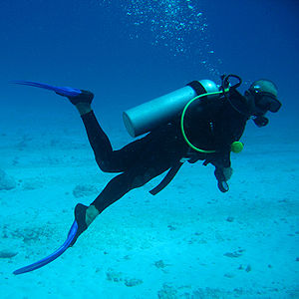
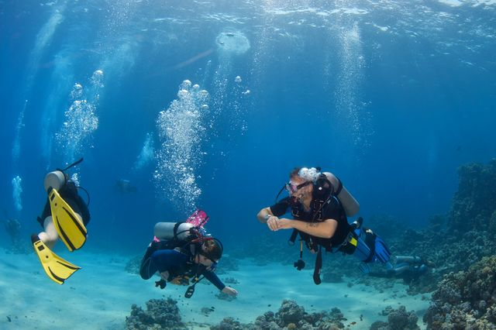
Would you like to learn scuba diving?

Slide 8
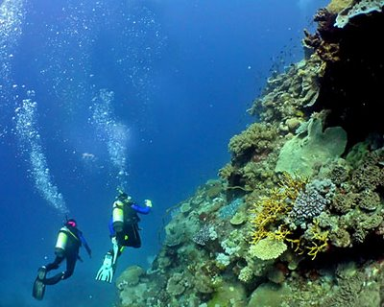
You can join a club to learn to scuba dive.

Slide 9


join a club

Slide 10


Look at the pictures and say the new words.
Let’s see how many words you can say remember.

Slide 11

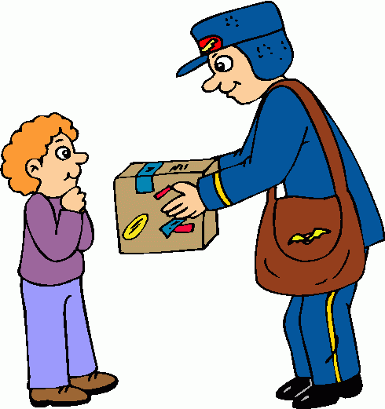
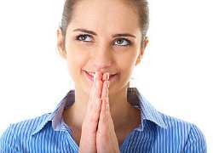


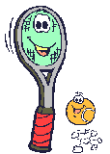

receive
look forward to
final
racket

Slide 12

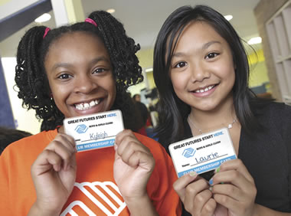
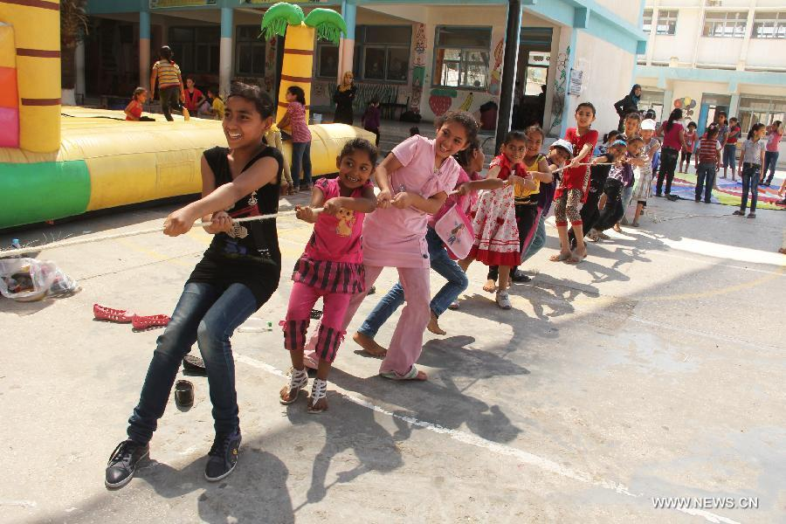

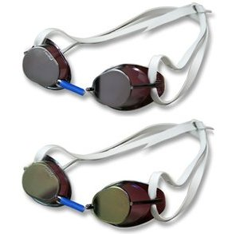
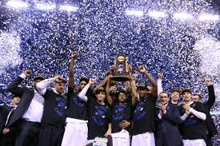
join a club
take part in
goggles
championship

Slide 13

Choose the correct word from a,b,c and d:
looking forward to
1-My cousins are ………………….……….seeing you, they heard a lot about you.
a- join a club b- communicate c- receive d- looking forward to
2-She is a smart student because she got high marks in her …………………. exam.
a- final b- fatal c- bright d- boring
3-If you want to play tennis with us, you have to bring your own ………………
a- championships b- subjects c- rackets d- goggles
4-You have to ……………….. if you want to learn how to paint.
a- receive b- communicate c- join a club d- take part in
final
racket
join a club

Slide 14
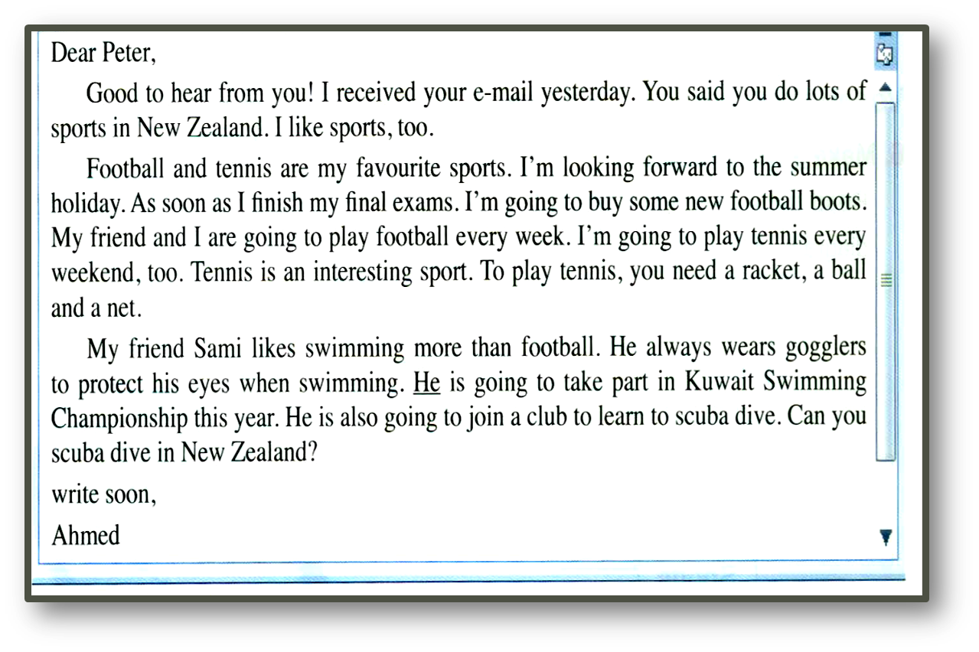
Read the e-mail carefully to answer the following questions
goggles

Slide 15


Slide 16
Read the e-mail again to answer the previous questions. Then check your answers

Slide 17

1- Who sent the e-mail?
a) Peter
b) Ahmed
c) Sami
d) Peter and Ahmed

Slide 18

2- When is Ahmed going to buy new shoes?
a) every week
b) yesterday
c) every weekend
d) after his final exams

Slide 19
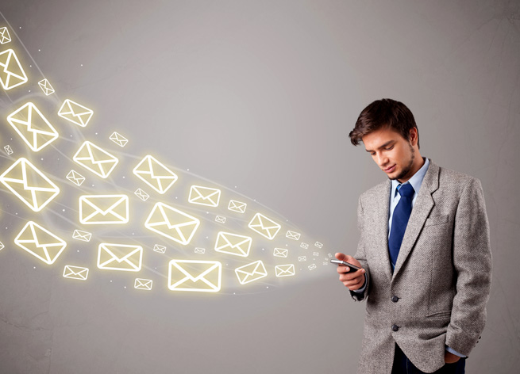
3- How can you tell that Sami is a good swimmer?
a) He likes swimming more than football.
b) He is going to take part in Kuwait Swimming Championship.
c) He is going to join a club to learn to scuba dive.
d) He always wears goggles to protect his eyes.

Slide 20
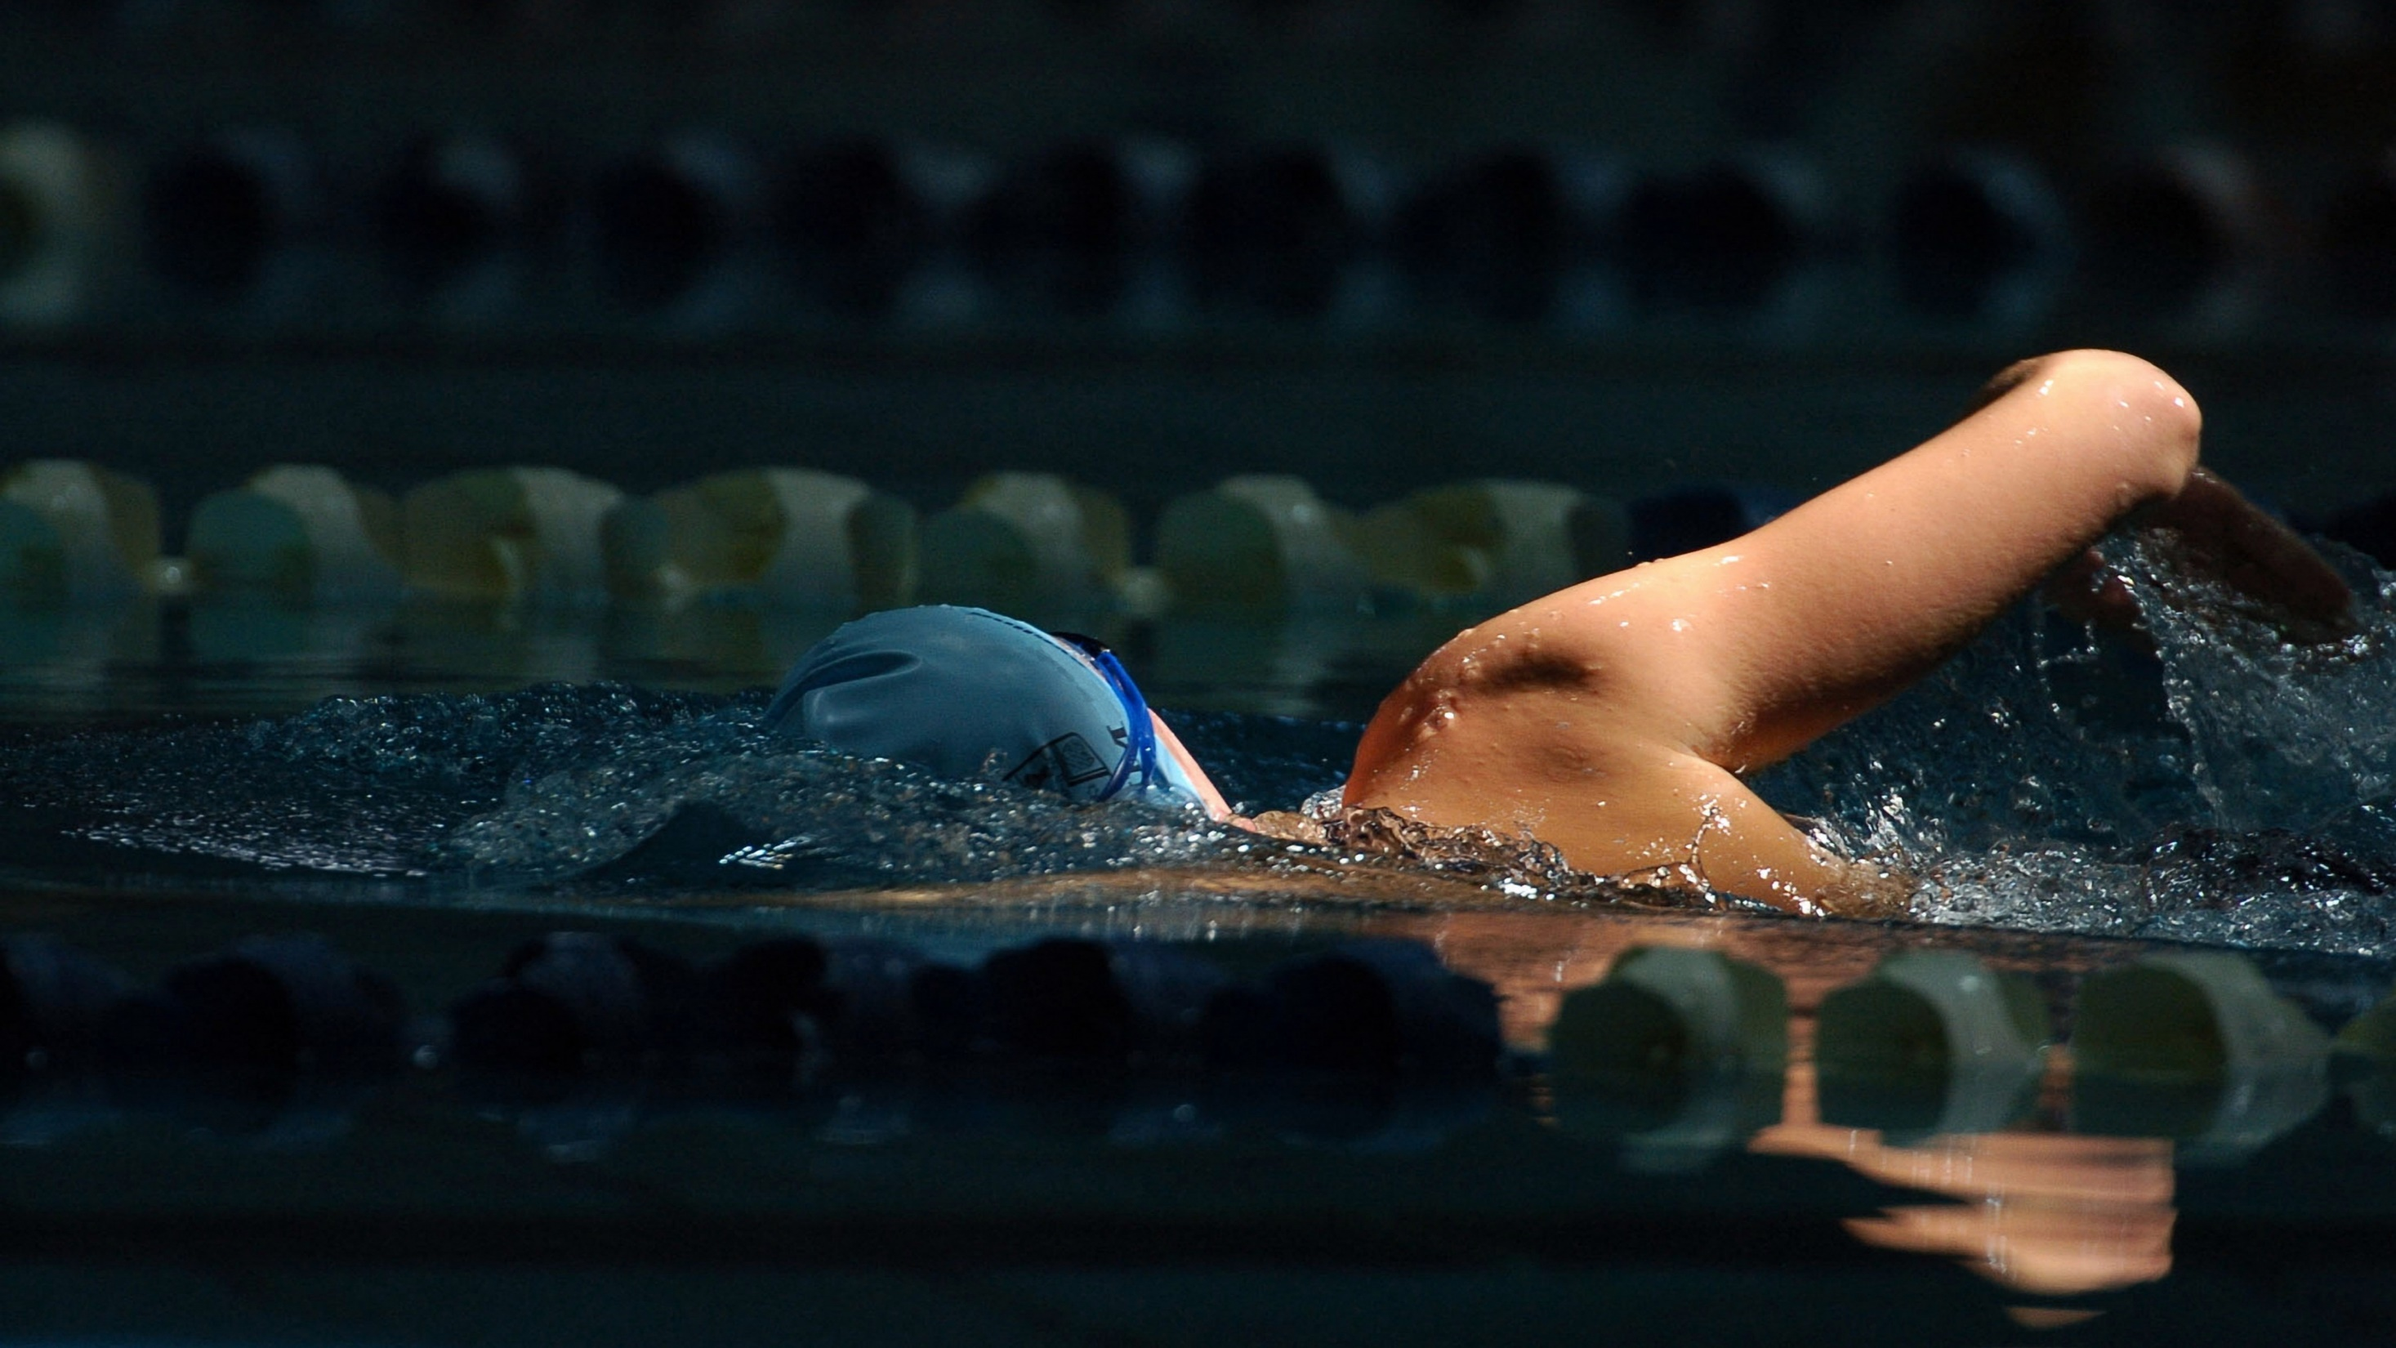
4- What does the underlined pronoun He refer to?
He is going to take part in Kuwait Swimming Championship this year.
The underlined pronoun He refers to --------------.
a) Ahmed
b) Peter
c) Sami
d) Sami and Ahmed

Slide 21
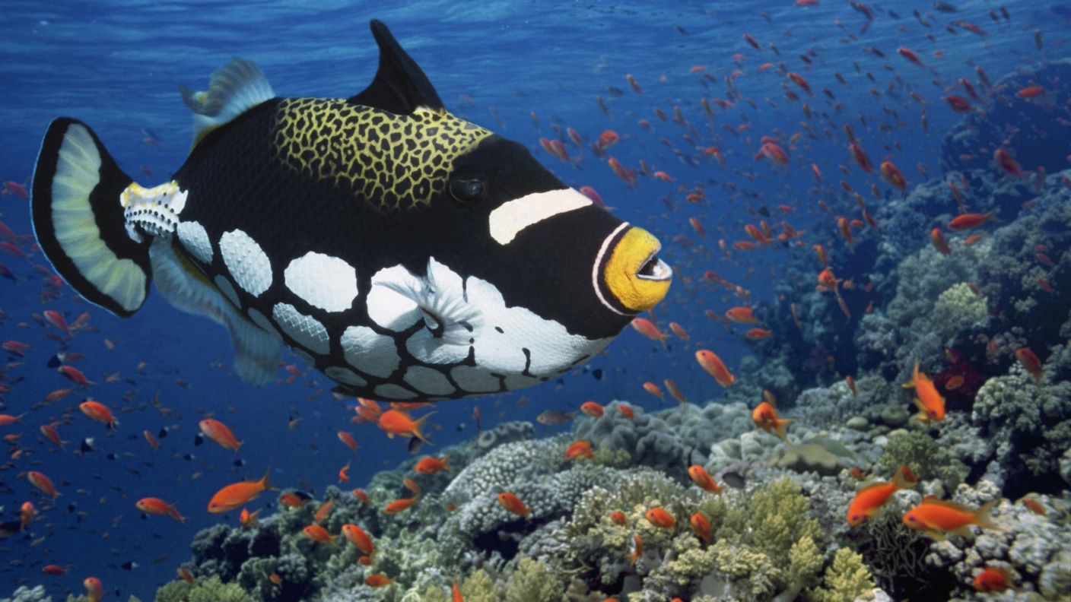
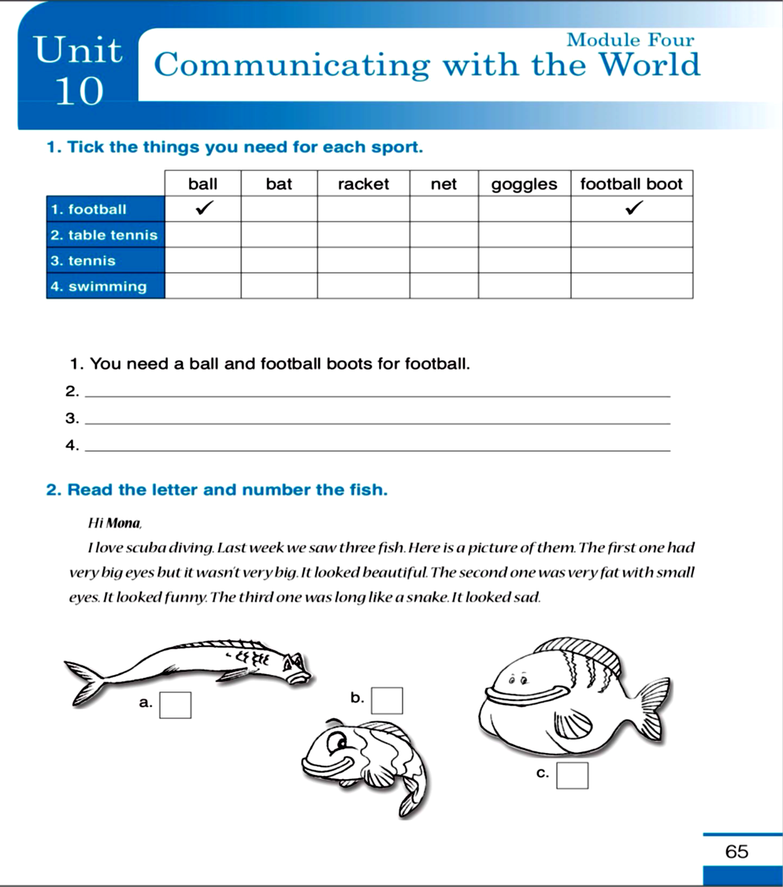
Workbook
page 65

Slide 22
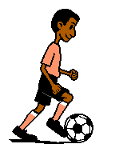
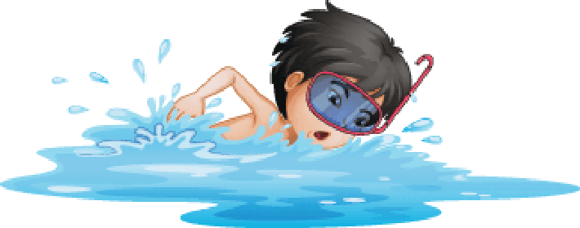
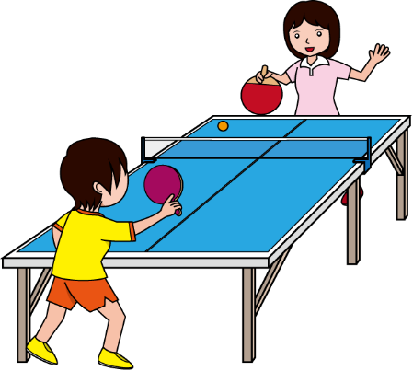
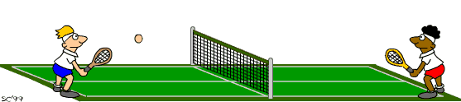

Slide 23
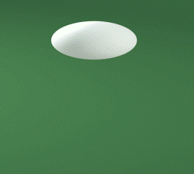
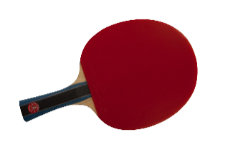
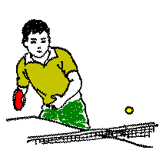
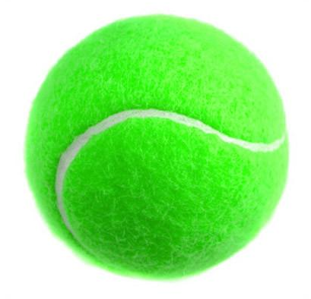
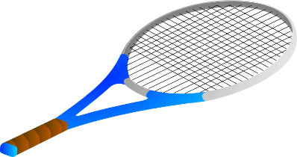
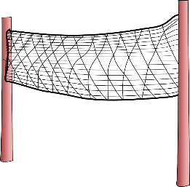
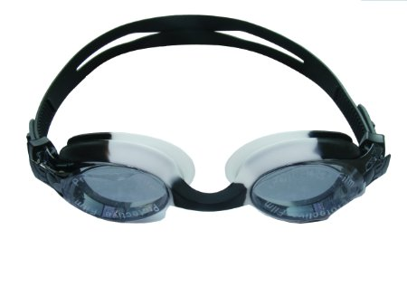

Slide 24
3
1
2

Slide 25
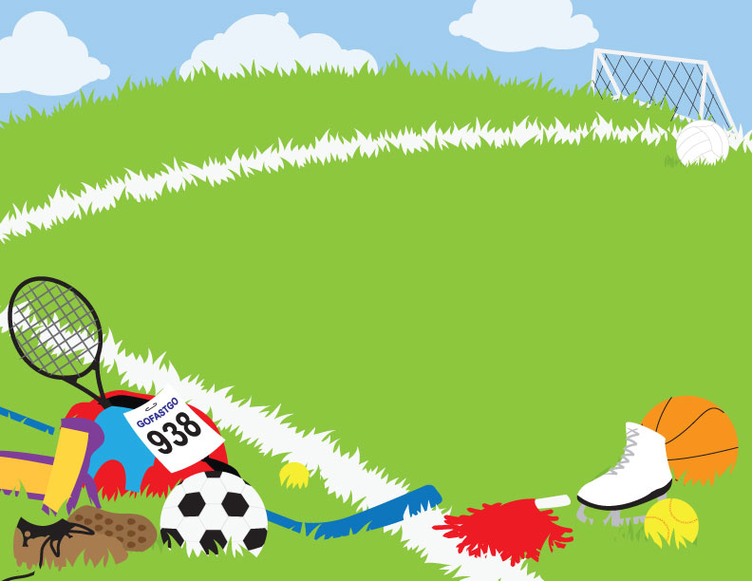
What are your favourite sports?
My favourite sports are swimming
and scuba diving. What about you ?

Slide 26
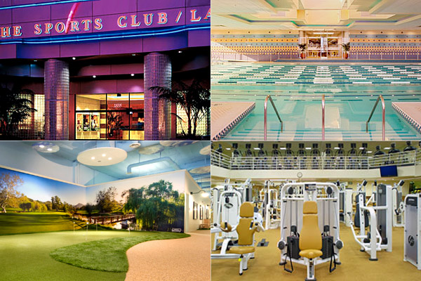
Would you like to join a sports club? Why? Why not?
I would like to join a swimming club
to be fit and healthy.

Slide 27
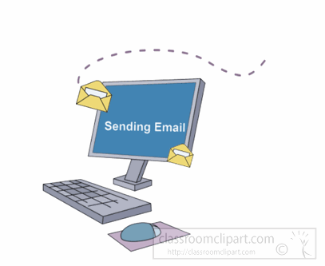
Do you think that writing
e-mails is important? How?
I think writing emails is important because
it is an easy way to communicate with people.

Slide 28


Surf the Net and find information about Kuwait Swimming Championship.

Slide 29
